Slide 1
Acoustic identification of insects
Ed Baker

Slide 2
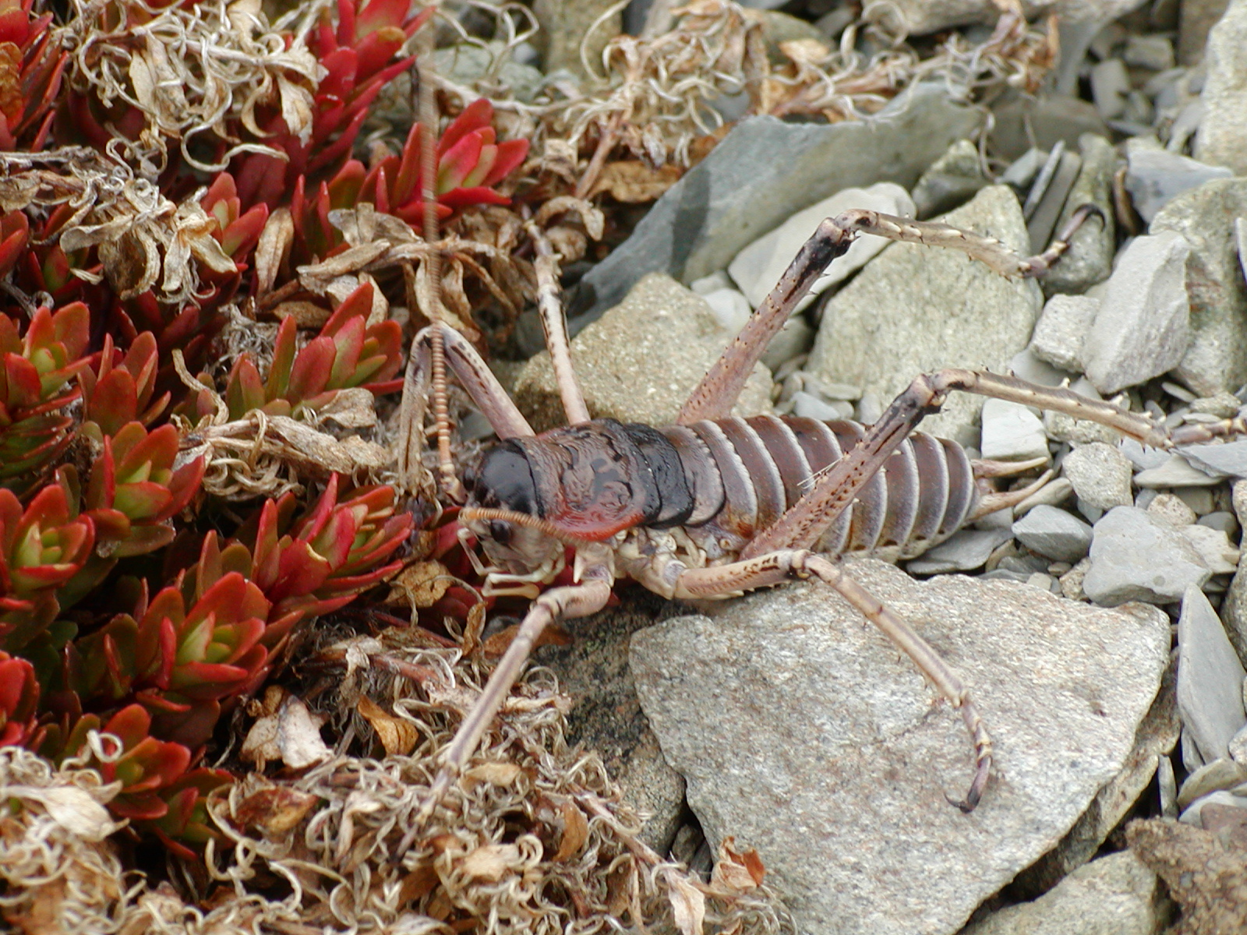
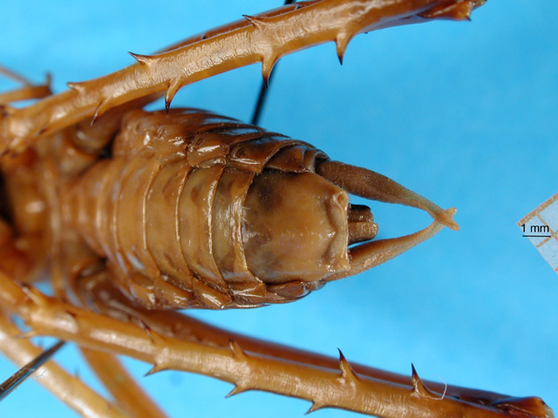
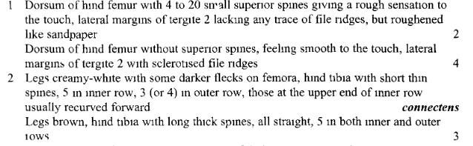

Slide 3
Organism
Characters
Identification

Slide 4
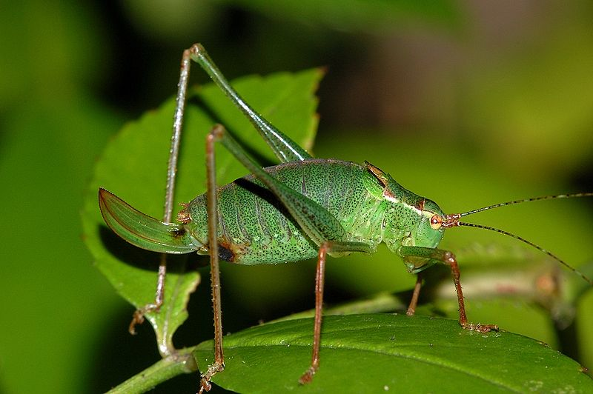
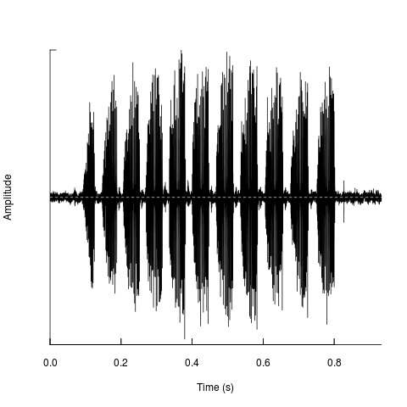
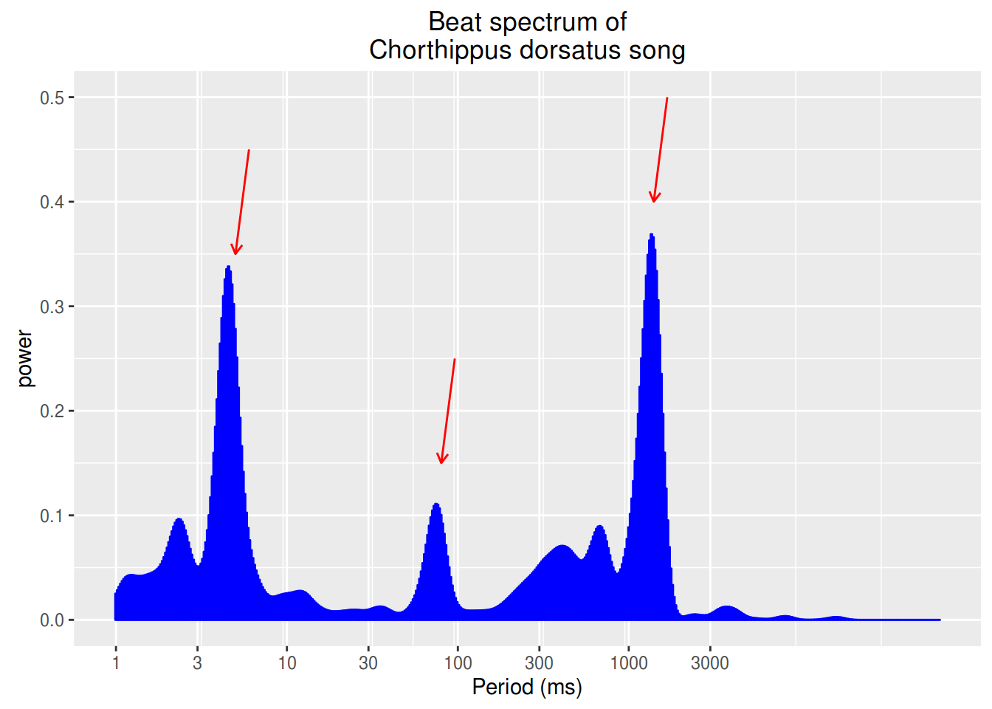
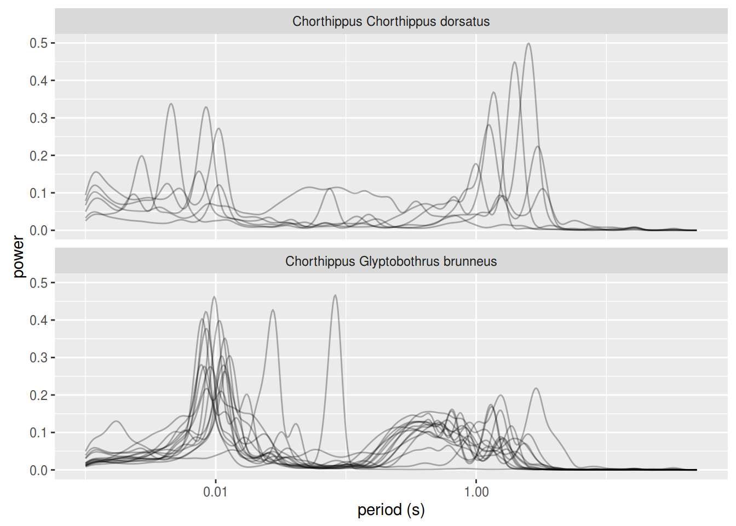
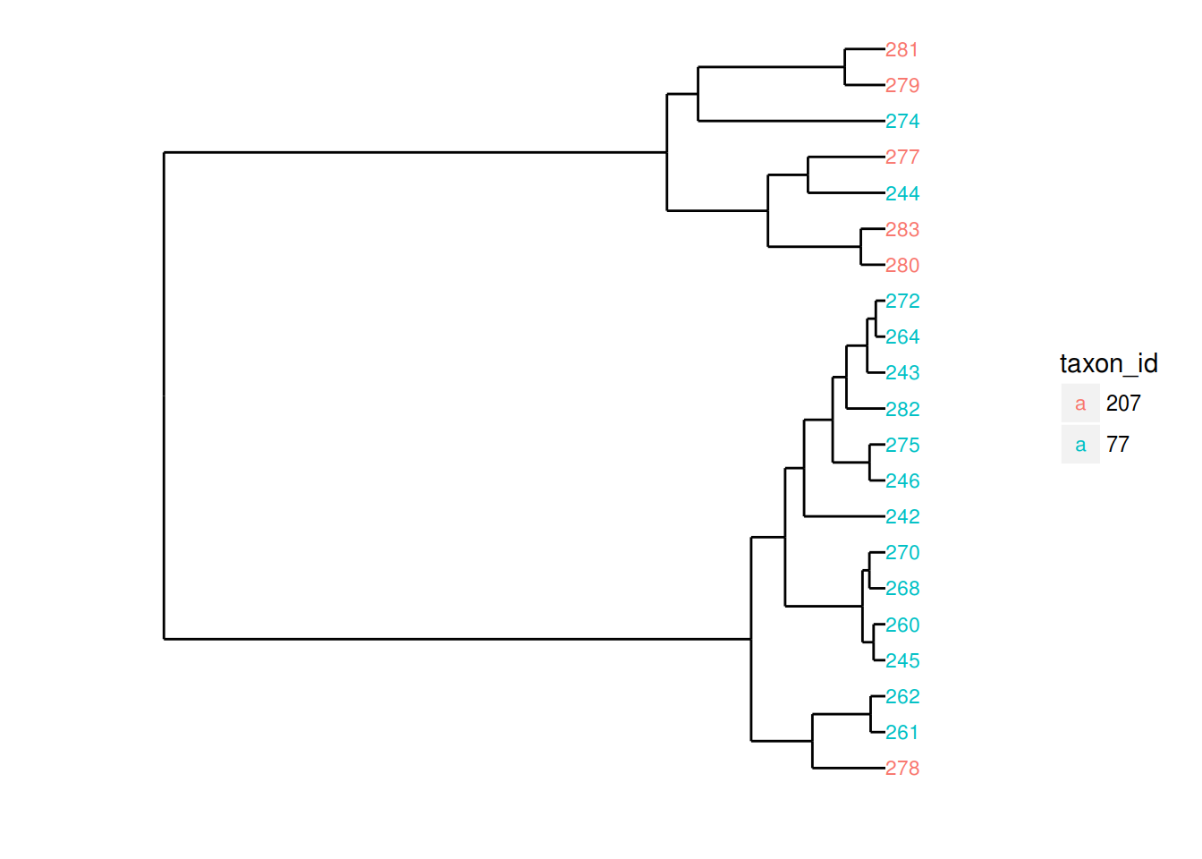
Organism
Feature Extraction
Classification

Slide 5
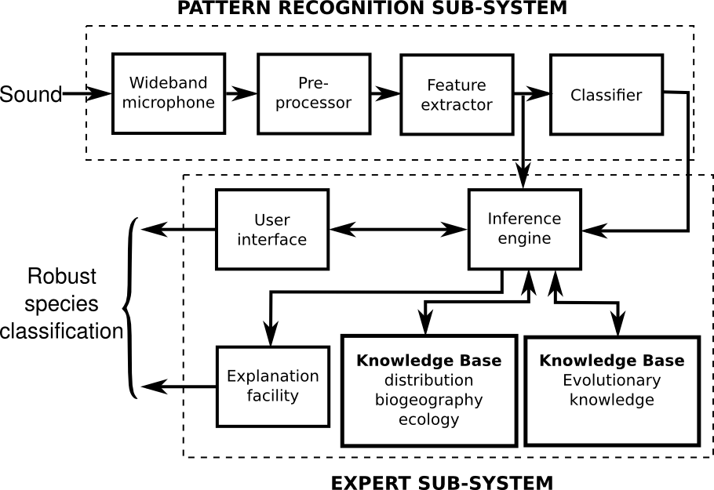

Slide 6
Leptophyes punctatissima

Slide 7
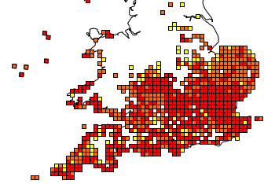
Leptophyes punctatissima
1980-1990
1990-2000
2000-2010

Slide 8
Leptophyes punctatissima
1980-1990
1990-2000
2000-2010

Slide 9
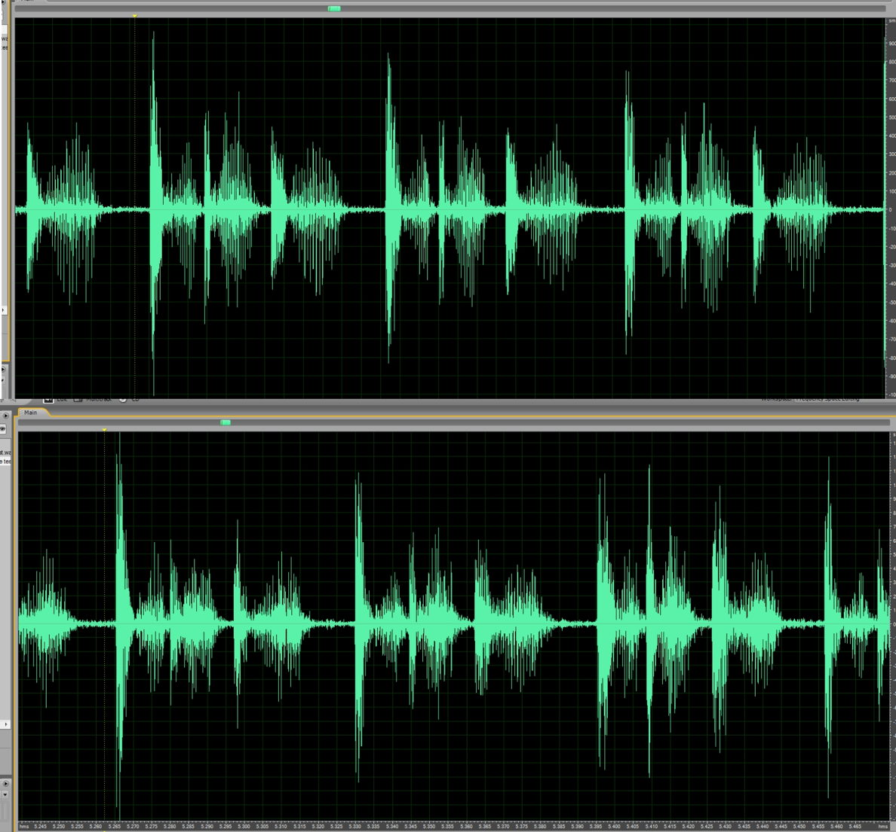
Leptophyes punctatissima

Slide 10
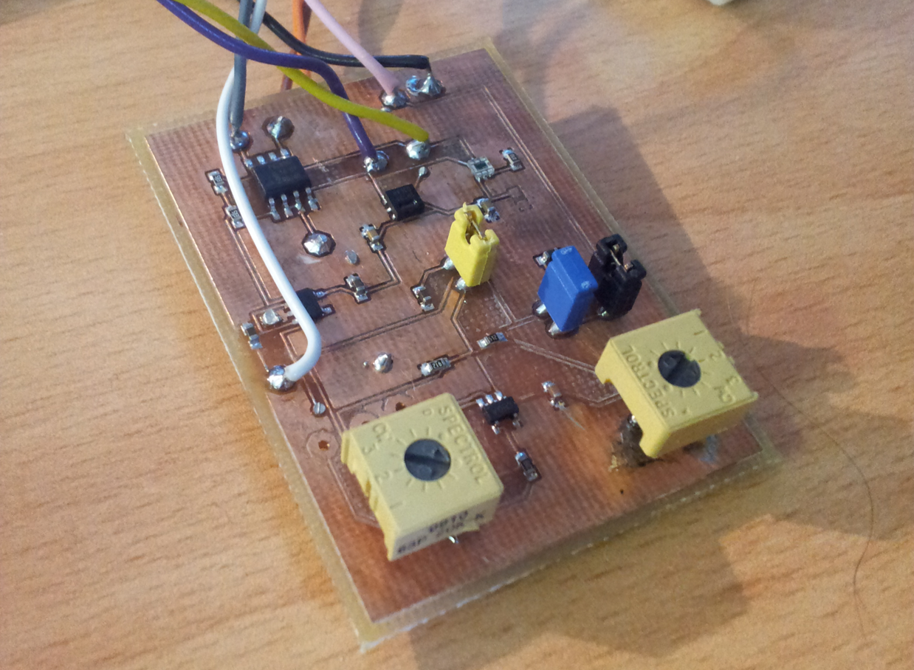
Leptophyes punctatissima

Slide 11
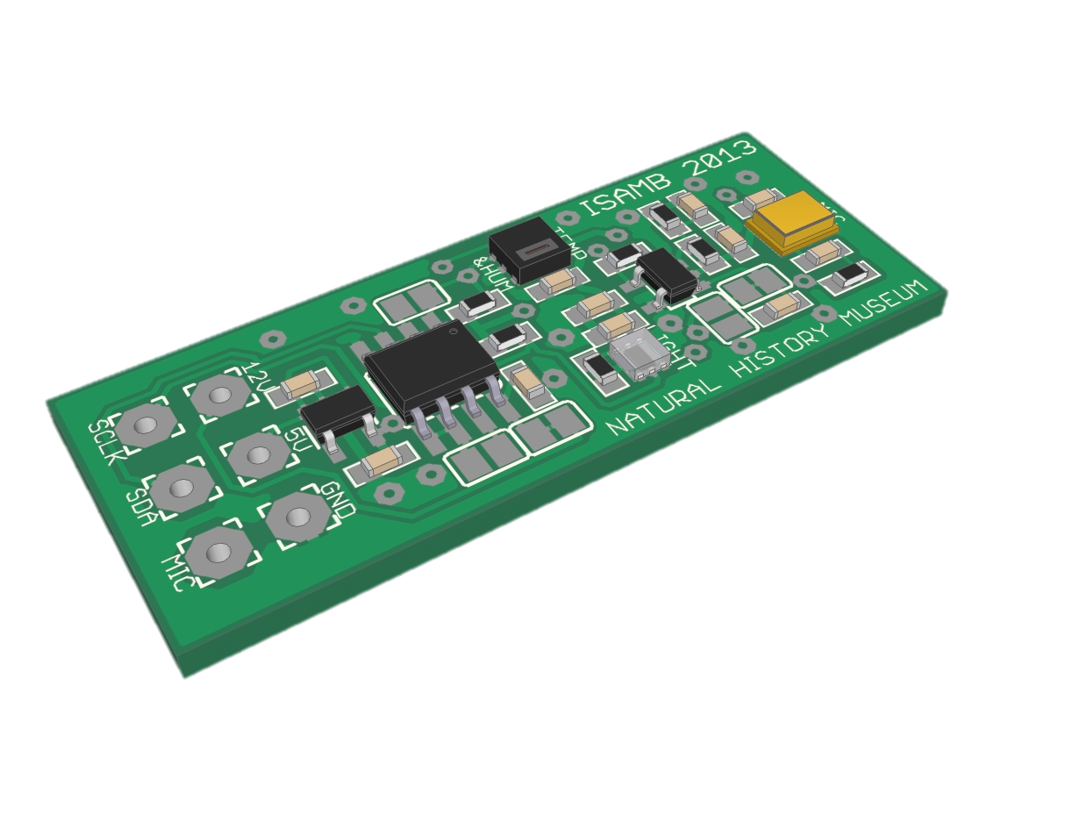
Leptophyes punctatissima

Slide 12
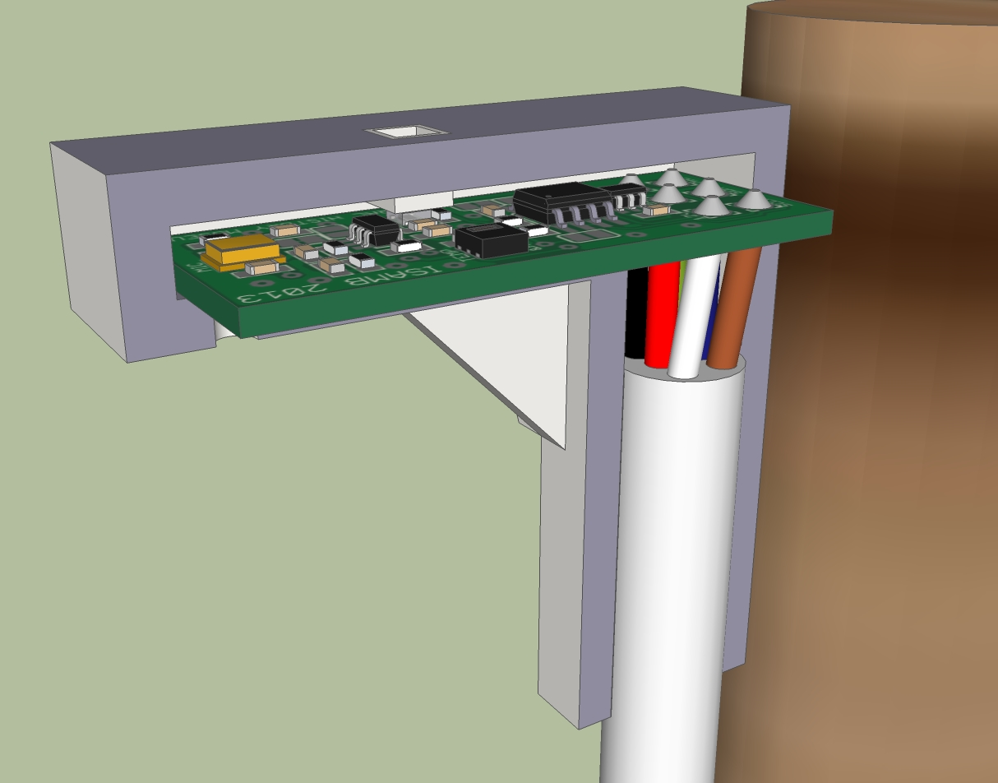
Leptophyes punctatissima

Slide 13
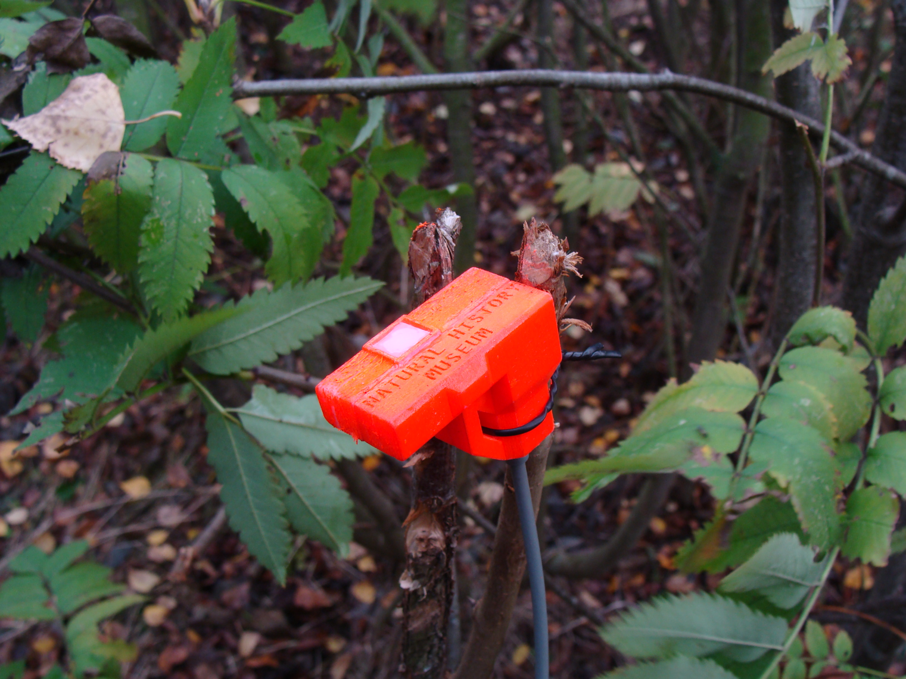
Leptophyes punctatissima

Slide 14
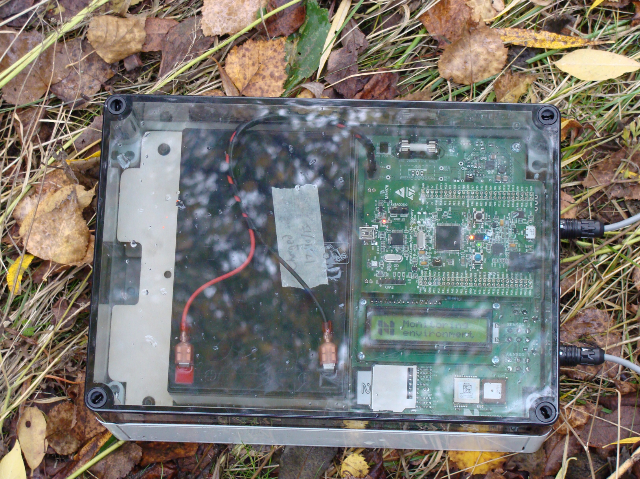
Leptophyes punctatissima

Slide 15
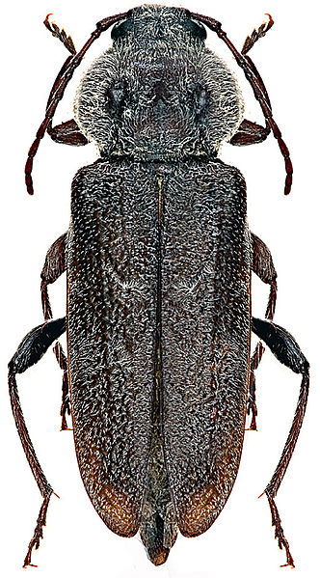
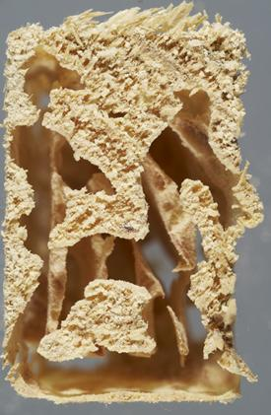
Boring beetles

Slide 16
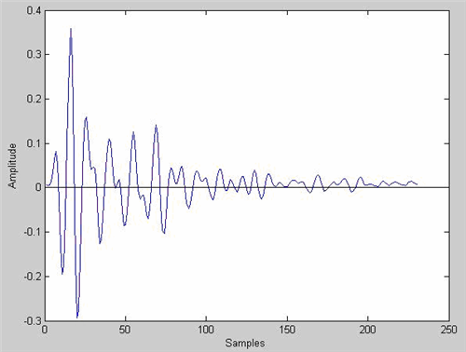
Boring beetles

Slide 17
Boring beetles

Slide 18
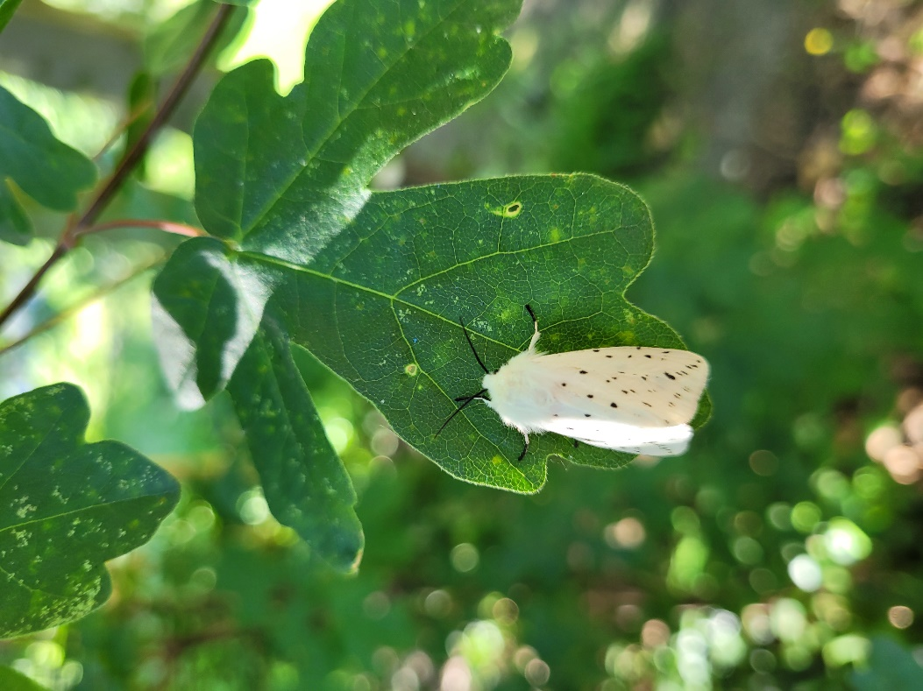
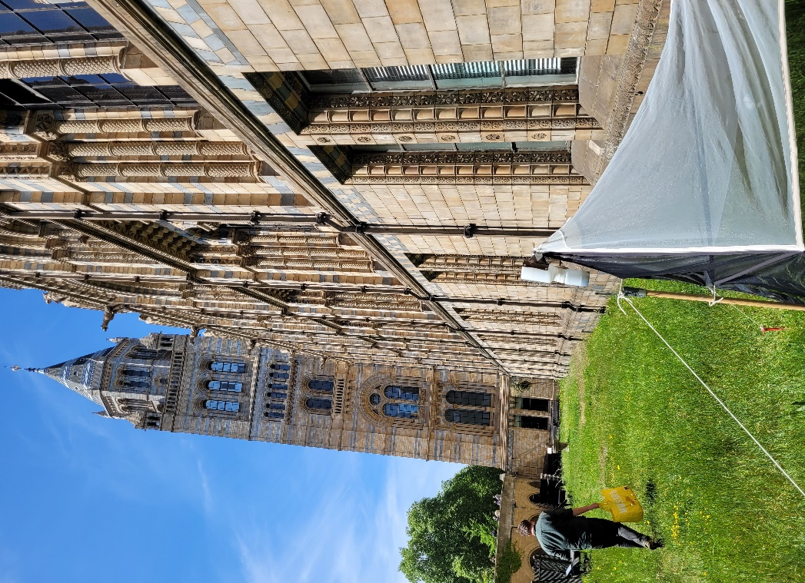
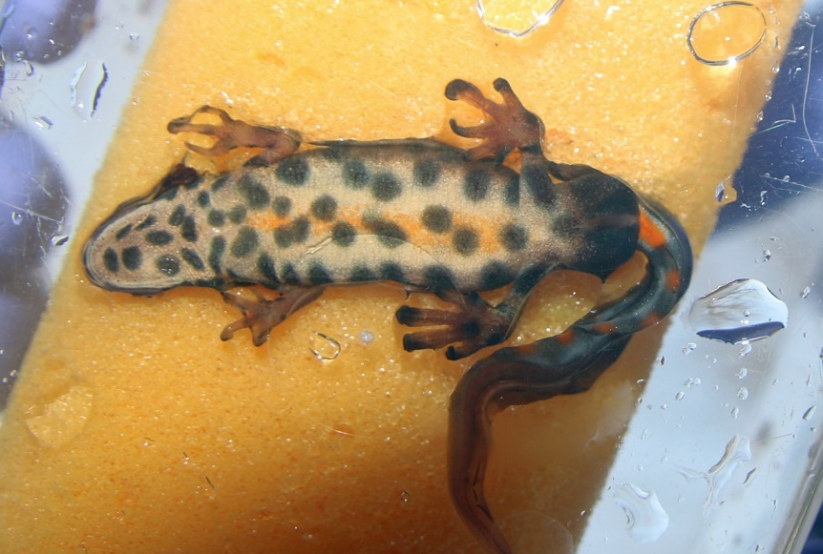
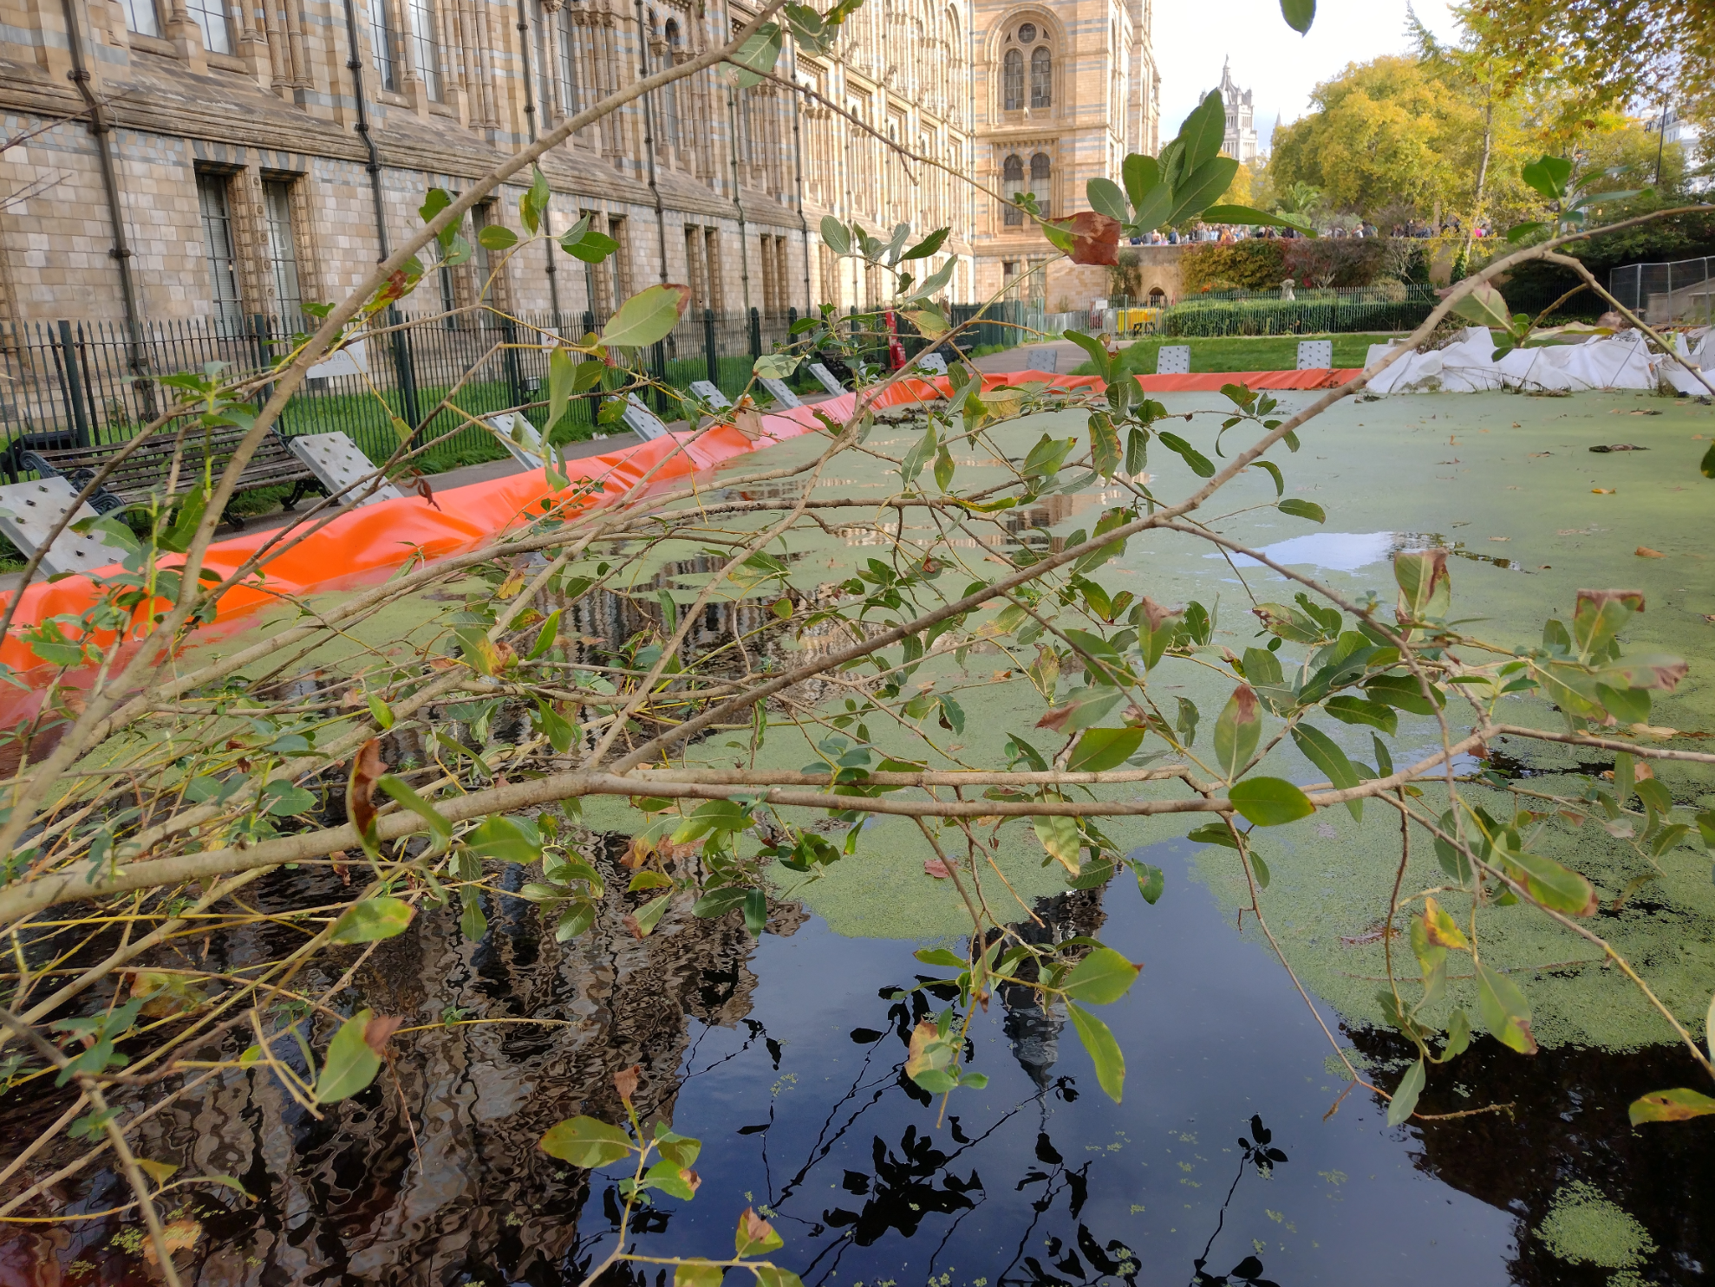
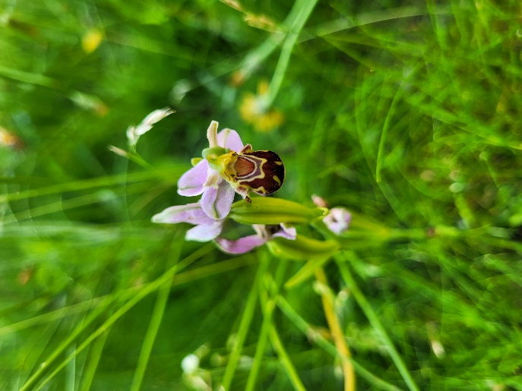
Preparing for the gardens build
Spot-pattern recognition to track population

Slide 19
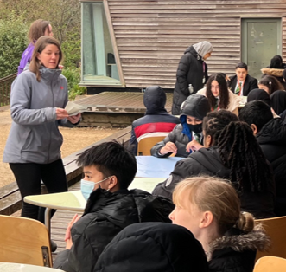
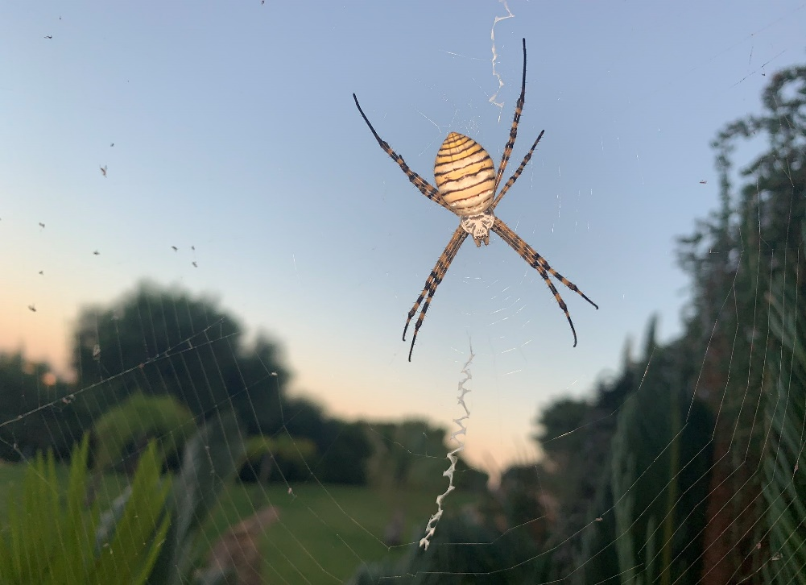
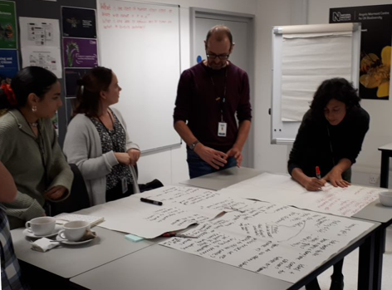
Community science
How can we make roads better for nature?
Argiope bruennichi , @QuestChronicle

Slide 20
Example: URBAN ROAD NOISE
It is estimated that the annual social cost of urban road noise in England is £7 billion to £10 billion. What is the cost to wildlife?
Most studies focus on mammals
What about non-airborne sounds?
Can we find mitigations that also support biodiversity recovery?

Slide 21
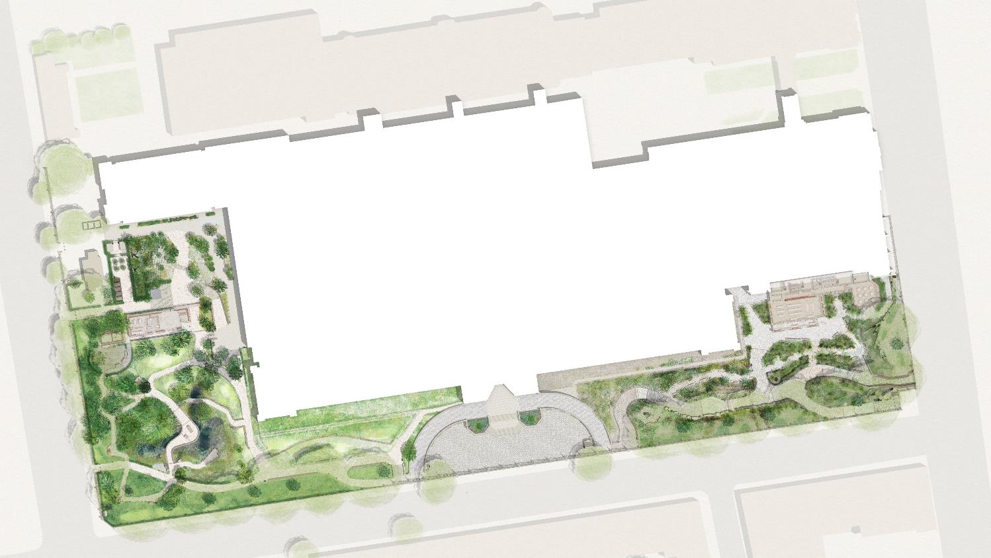
We currently monitor ‘our’ biodiversity using visual and eDNA methods
2024 onwards will also include bioacoustic and environmental parameters across a 25 point IoT sensor array
Long-term monitoring plus detailed case studies of how habitat translocation, creation and restoration actions impact biodiversity
Data infrastructure to capture, share and support co-analysis and visualisation of these multiple data types

Slide 22
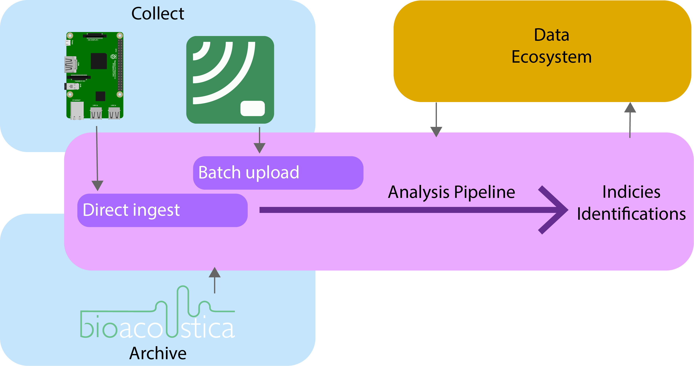
Acoustic pipeline

Slide 23
Practical on acoustic identification
http://learn.acousti.ca/

